Slide 1
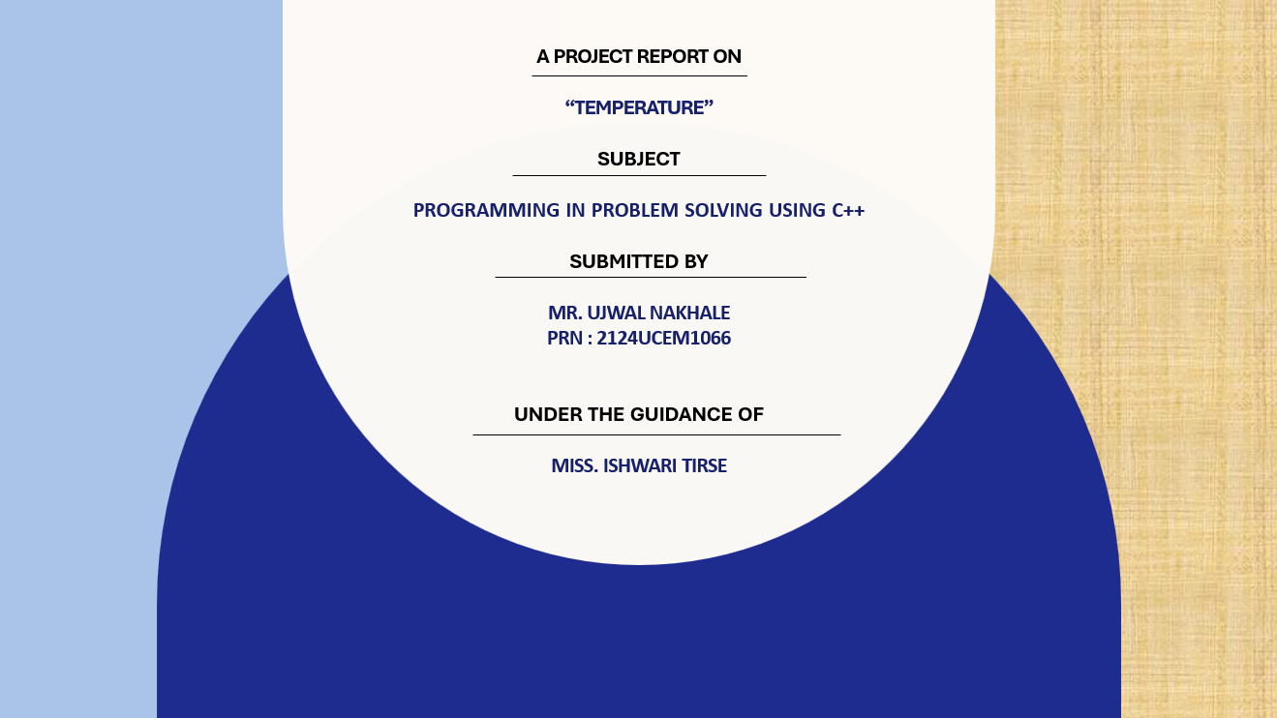
Capstone project 1
SYNOPSIS FOR THERMOMETER

Slide 2


Slide 3

SR.NO. | CONTENT | PAGE NO.
1. | INTRODUCTION | 4
2. | CODE | 7
3. | OUTPUT | 8
4. | CONCLUSION | 9

Slide 4
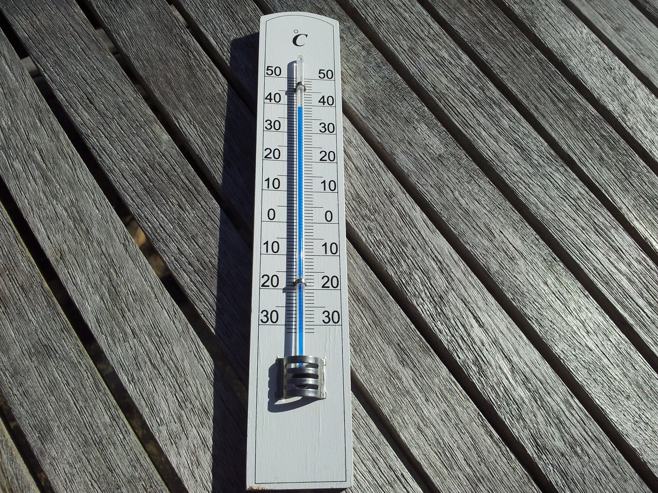
THERMOMETER
Introduction:
A thermometer is an essential instrument used to measure temperature. In this project, we aim to design a digital thermometer simulation using C++ programming. The program will capture a temperature reading, analyze it, and provide relevant feedback on whether the temperature is hot, cold, or normal. This project can serve as a fundamental part of more complex systems, such as medical devices, HVAC systems, or weather monitoring tools.

Slide 5
History and Evolution:
Thermometers have existed since the early 17th century, with Galileo's thermoscope being an early example. Over time, advancements led to mercury thermometers, digital thermometers, and infrared thermometers used today.
These devices have become crucial in many fields, including healthcare, meteorology, and industrial applications.
1- Galileo’s Thermoscope (1593)
2-Ferdinand II’s Sealed Thermometer (1654)
3-Development of the Mercury Thermometer (1714)
4-Alcohol Thermometers
5-Infrared and Non-contact Thermometers (21st Century)
Objective:
The main objective of this project is to simulate a basic thermometer using C++ to measure temperature and provide feedback. This simulation aims to demonstrate temperature classification and provide a fundamental framework for implementing more advanced temperature-related functions in real-world applications.

Slide 6
5. Tools and Technologies:
Programming Language:
1- C++IDE: Code::Blocks
2-Dev C++,
3- C++ compilerLibraries: Standard I/O libraries of C++ for basic input/output handling.
6. Software:
The software component of this project includes a C++ console application that Accepts user input for temperature Processes and categorizes the temperature Displays the result to the user.
7. Technologies:
This project leverages basic C++ programming concepts, such as Object-Oriented Programming (OOP).Input/output handling using standard I/O libraries. Conditional statements for temperature classification.

Slide 7
Code:

Slide 8
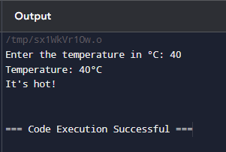

Slide 9
12 Conclusion:
The thermometer project in C++ serves as a practical demonstration of temperature measurement and processing. By implementing basic object-oriented programming principles and providing a clear output to the user, this project highlights the potential of C++ in creating simulation tools for real-world applications. This project can be expanded into more complex systems with sensor integration and GUI development for a wide range of uses, from healthcare to industrial monitoring.
Name: Ujwal Nakhale
PRN:2124UCEM1066
Dept: CSE

Slide 10


